Slide 1
COMSAT: Modulo Scheduling Technique for Unknown Trip Count and Early Exit Loops
Quoc Long Vinh Ta
Aviral Shrivastava

Slide 2
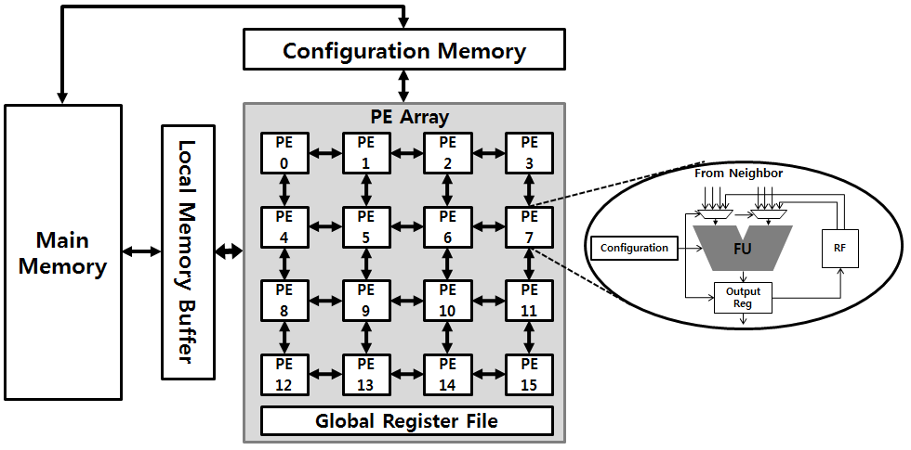
Introduction - CGRA
Comprised of processing elements laid out in 2D mesh, capable of ALU/FU and memory ops
Each PE consists of register file and input muxes.
Configuration memory stores all instructions for every PE at every cycle
Execute on repetitive loops, parallelism exploited by modulo schedule technique
Innermost loops only

Slide 3
Introduction - CCF
Loop Extraction
LLVM frontend passes to extract the loop
DFG generation
Frontend pass to extract loop from IR
Support for nested loops
Mapping on Target CGRA
Loop Annotation
Pragma CGRA on the loop of C file
Include Target CGRA CSV and the execution script
Generate IR for the CGRA
Schedules and Maps on the CGRA
Includes support for IMS CRIMSON -- Also support for multiple mapping algos.
Instruction Generator
From the mapping and DFG generate machine instructions.
Support for multiple DFG structures, single precision floating point support.
Architectural Simulation
gem5 based CGRA simulation. Support for multiple CGRA dimensions.
Support for Single Precision FP Executions.
App
LLVM
C++
C++
gem5

Slide 4
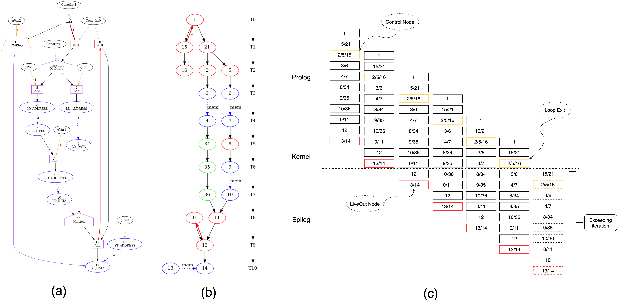
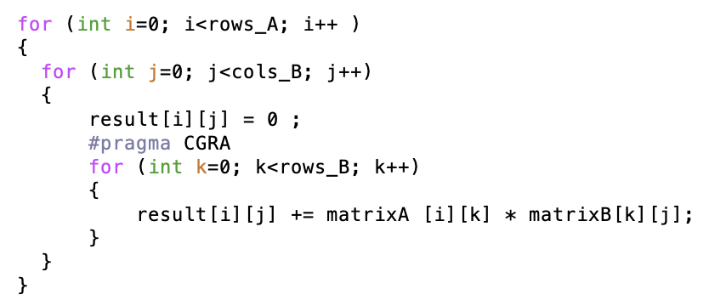
Background - Compilation
1
1
k
21
4
15
Mult
Rows
B
Add
5
General Matrix Multiplication
A[i]
B
Add
16
6
EQ
2
Addr
Add
7
3
j
Load
Addr
8
4
Add
Load
9
LCE
Addr
10
0
Load
C[i][j]
11
Mult
12
Add
C
14
13
Store
Addr
Notes:
Node 16 evaluates loop condition -> control node
Node 13 stores to memory -> live out node

Slide 5
Background – Modulo Scheduling
Modulo schedules have 3 stages: prolog, kernel, epilog
A loop stage is a set of operations found in kernel that belong to the same iteration
II: initiation interval, a performance metric for modulo schedule → the smaller the better
Loop Stages
1
II = 2 cycles
15/21
2/5/16
3/6
4/7
8/34
9/35
10/36
0/11
Loop Stage
12
13/14
Notes:
Control and live out nodes
Live out affects loop correctness because they hold loop outcome
II = number of cycles for starting new iteration
-> The smaller the more parallelism -> the better schedule -> performance metric
Loop stage: set of operations belonging to 1 iteration in a kernel trip count

Slide 6
CGRA Execution on Modulo Schedules
Cycle:
Generated Mapping for II = 2:
Cycle 0:
X 9 7 5
11 35 X X
13 14 4 16
0 X 2 1
Cycle 1:
10 X 8 6
X 36 X X
12 34 3 15
X X X 21
1
2
3
4
5
6
7
8
9
10
11
12
13
14
15
16
9
7
8
6
17
10
5
18
19
20
36
21
11
35
22
Cycle 14:
Cycle 13:
Cycle 21:
Cycle 17:
Cycle 1:
Cycle 2:
Cycle 3:
Cycle 7:
Cycle 18:
Cycle 8:
Cycle 9:
Cycle 23:
Cycle 6:
Cycle 16:
Cycle 5:
Cycle 4:
Cycle 10:
Cycle 12:
Cycle 11:
Cycle 22:
Cycle 20:
Cycle 15:
23
Cycle 19:
14
15
34
4
16
13
3
12
21
1
0
2
1
Notes:
After every II cycles, a new iteration started
Multiple iterations

Slide 7
Speedups Achieved by Modulo Schedule
1.43x speedup
2x speedup
Experiment Setup:
CPU: single-threaded, single-core ARMv7a
CGRA: 4x4 register size of 8
Cycles by Gem5
How CGRA Achieved Speedups:
Multiple iterations in a cycle
Multiple operations for each iteration in a cycle
Supported by multiple PEs

Slide 8
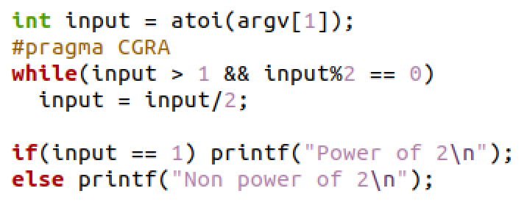
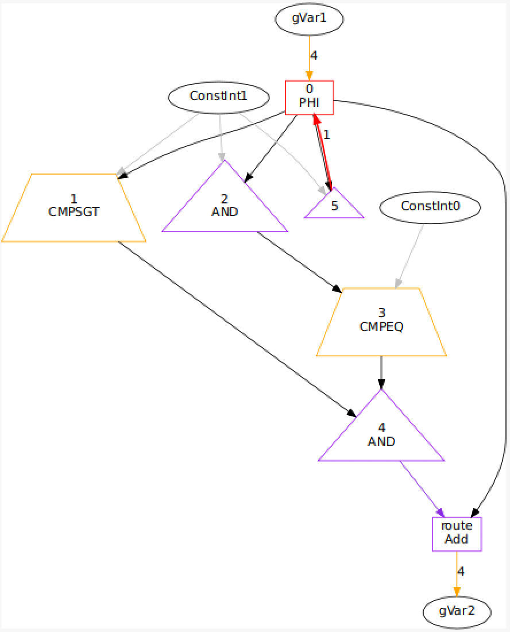
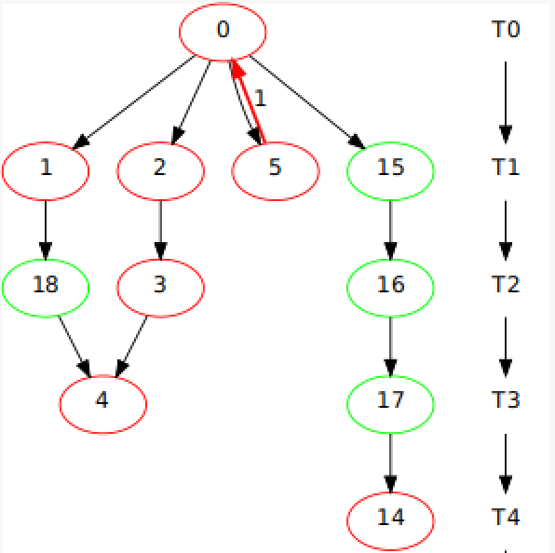
The Exit Problems
Non-predictable trip count
Unknown trip count: CGRAs exceed intended number of iterations
Early exits: modulo schedules have minimum number of iterations and CGRA cannot execute fewer than that
0
Loop Exit
1/2/5/15
3/16/18
0
4/17
1/2/5/15
14
3/16/18
0
4/17
1/2/5/15
14
3/16/18
0
4/17
1/2/5/15
14
3/16/18
4/17
14
Exceeded Iterations
Notes:
Exit statements: trip counts are always unknown and CGRAs can only exit on loop conditions

Slide 9
Related Works
Tiramulai:
Limited predicating register size -> limited number of iterations in the pipeline
When the predicating register has state like 111011 where the 0 should terminate the loop and CGRA switched to epilog, which contains some further iterations, the succeeding 1s would imply that these exceeded iterations are executed and gives incorrect results
LASER:
Predicating nodes have to be ordered correctly → increases complexity
Issues instructions dynamically at runtime based on predicated outcomes
Limited size buffer for conditions → not scalable for bigger loops
Notes:
Tiramulai: gives the unknown trip count execution table from the HP paper and explain above 2 points
LASER: show figure 5 and 7 to explain above points

Slide 10
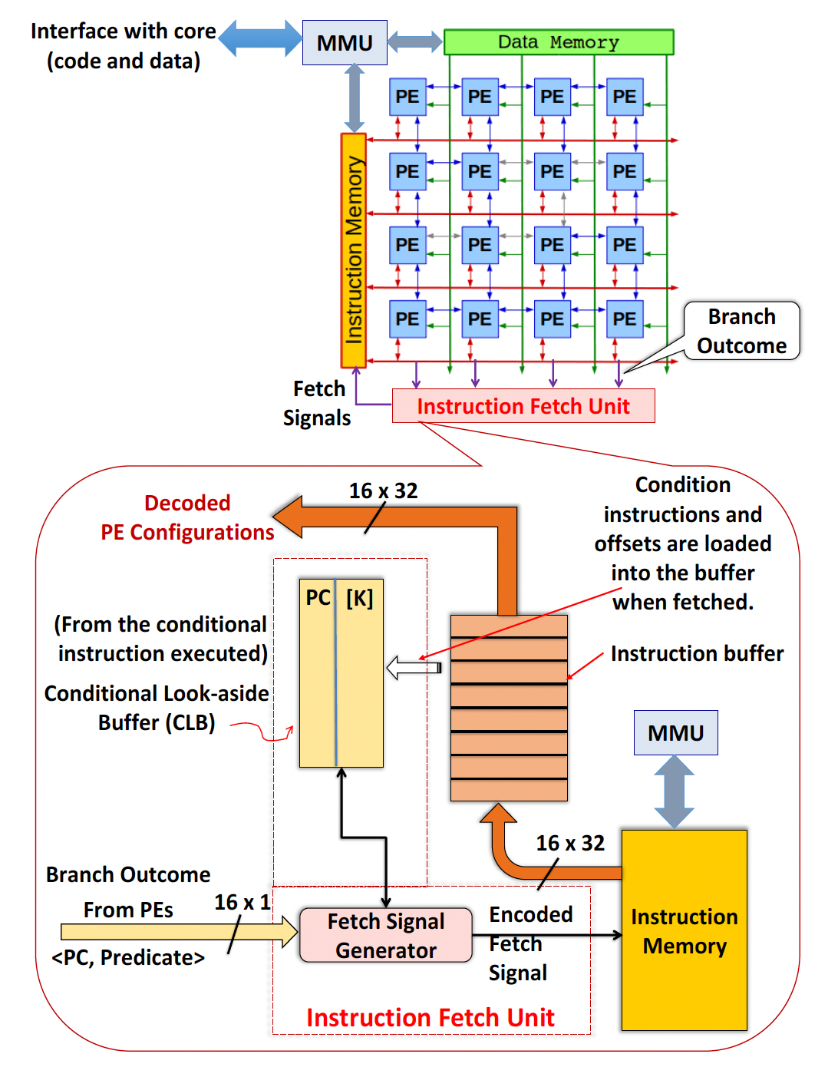
Current State of the Art – Dynamic Issuance
Introduced by Mahesh
Instructions are only issued when predicate buffer asserts

Slide 11
1
1st iteration condition
15/21
2/5/16
1
2nd iteration condition
Running GEMM for 7 iterations
3/6
15/21
4/7
2/5/16
1
3rd iteration condition
8/34
3/6
15/21
9/35
4/7
2/5/16
1
10/36
8/34
3/6
15/21
0/11
9/35
4/7
2/5/16
1
Loop Exit
7th iteration condition
8/34
3/6
15/21
6th iteration condition
12
10/36
7th iteration start
13/14
0/11
9/35
4/7
2/5/16
1
8th iteration start
Kernel Start
12
10/36
8/34
3/6
15/21
Kernel Trip Repeat
Kernel End
13/14
0/11
9/35
4/7
2/5/16
1
12
10/36
8/34
3/6
15/21
13/14
0/11
9/35
4/7
2/5/16
12
10/36
8/34
3/6
4th iteration liveOut
13/14
0/11
9/35
4/7
12
10/36
8/34
13/14
0/11
9/35
12
10/36
13/14
0/11
Exceeded iteration liveOut
7th iteration liveOut
12
13/14

Slide 12
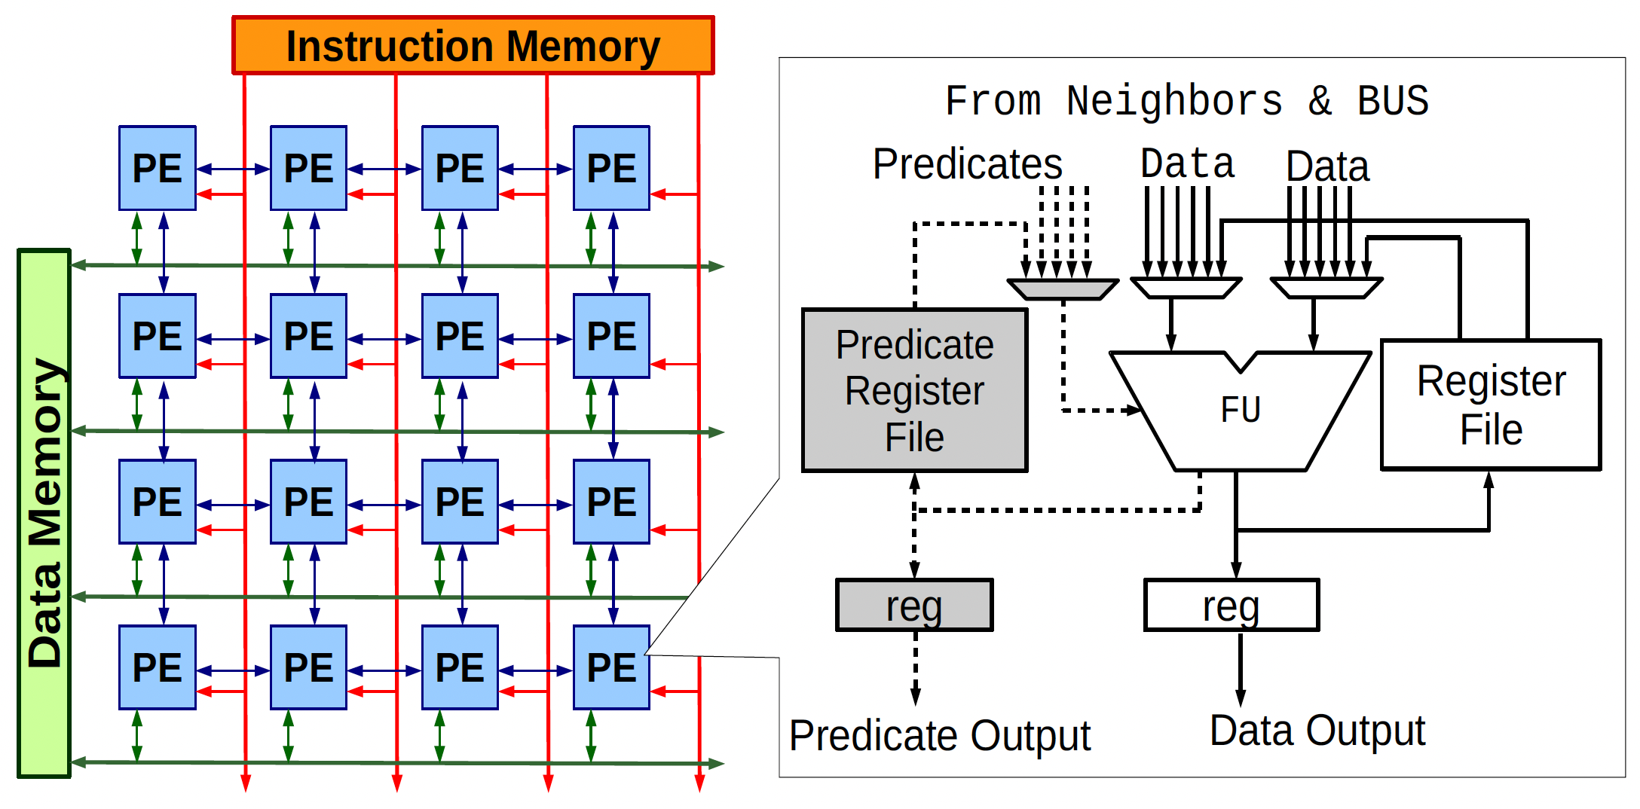
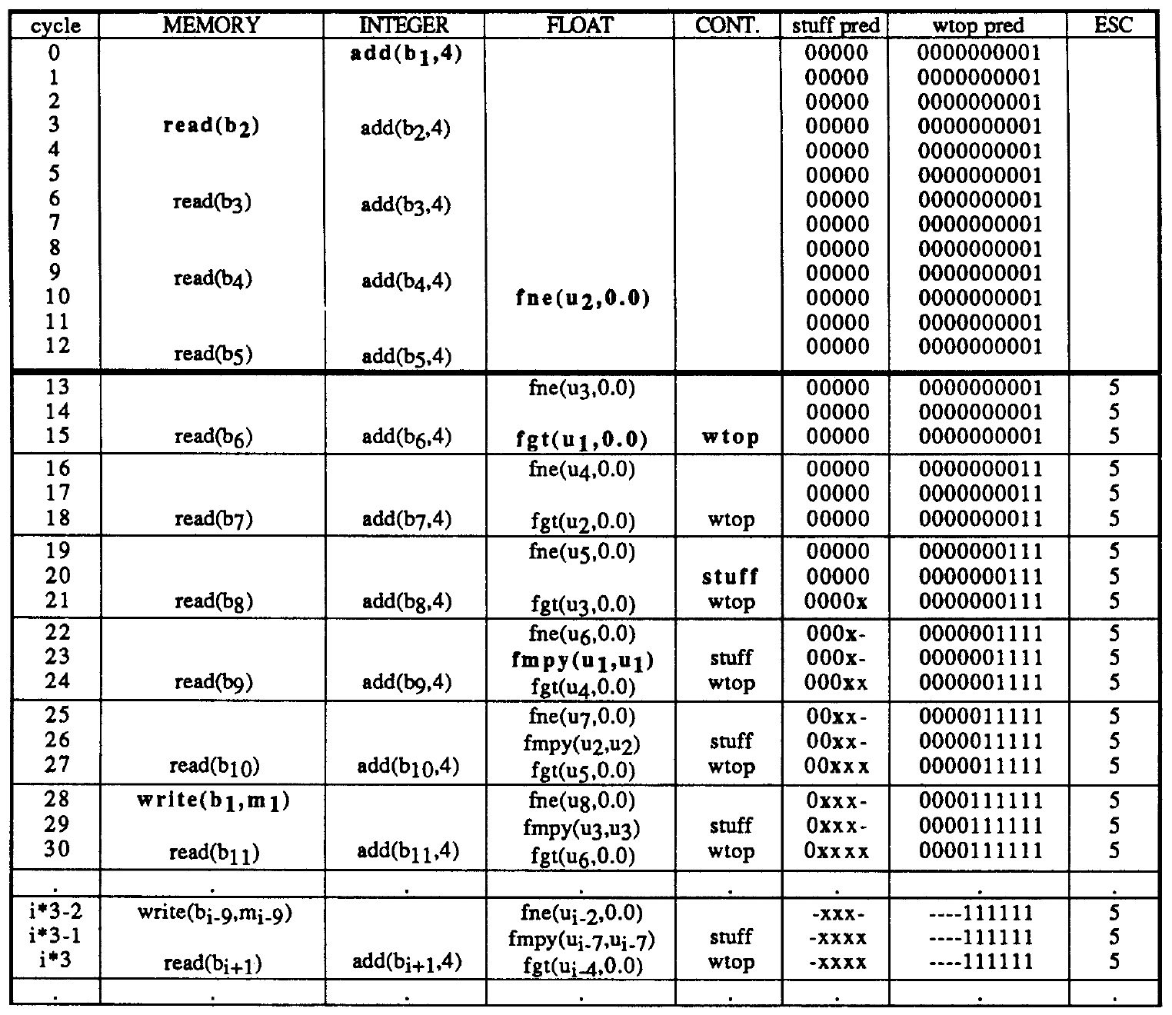
Current State of the Art
1
15/21
2/5/16
1
3/6
15/21
4/7
2/5/16
1
8/34
3/6
15/21
Predicate=0
-> NOOP
9/35
4/7
2/5/16
1
10/36
8/34
3/6
15/21
Predicate=1
-> Execute
0/11
9/35
4/7
2/5/16
1
12
10/36
8/34
3/6
15/21
13/14
0/11
9/35
4/7
2/5/16
1
12
10/36
8/34
3/6
15/21
13/14
0/11
9/35
4/7
2/5/16
1
12
10/36
8/34
3/6
15/21
13/14
0/11
9/35
4/7
2/5/16
Introduced by HP and LASER
Limitation:
Limited register size → limited number of pipelined iterations
Does not work for EQ/NEQ conditions
Conditions only fails for the exiting iteration
Succeeding iterations’ conditions still assert
Exceeded iterations in epilog still get executed
12
10/36
8/34
3/6
0
13/14
0/11
9/35
4/7
0
0
12
10/36
8/34
0
0
13/14
0/11
9/35
0
12
10/36
Epilog
0
0
13/14
0/11
0
12
0
0
13/14
Epilog’s iteration predicate
(should be 0)
Notes:
- First introduced by Tiramulai, HP [1]
- Introduces a rotating predicate register file to every PE
- Loop condition for each iteration is saved to the predicate file
- Instruction is executed when corresponding predicate asserts

Slide 13
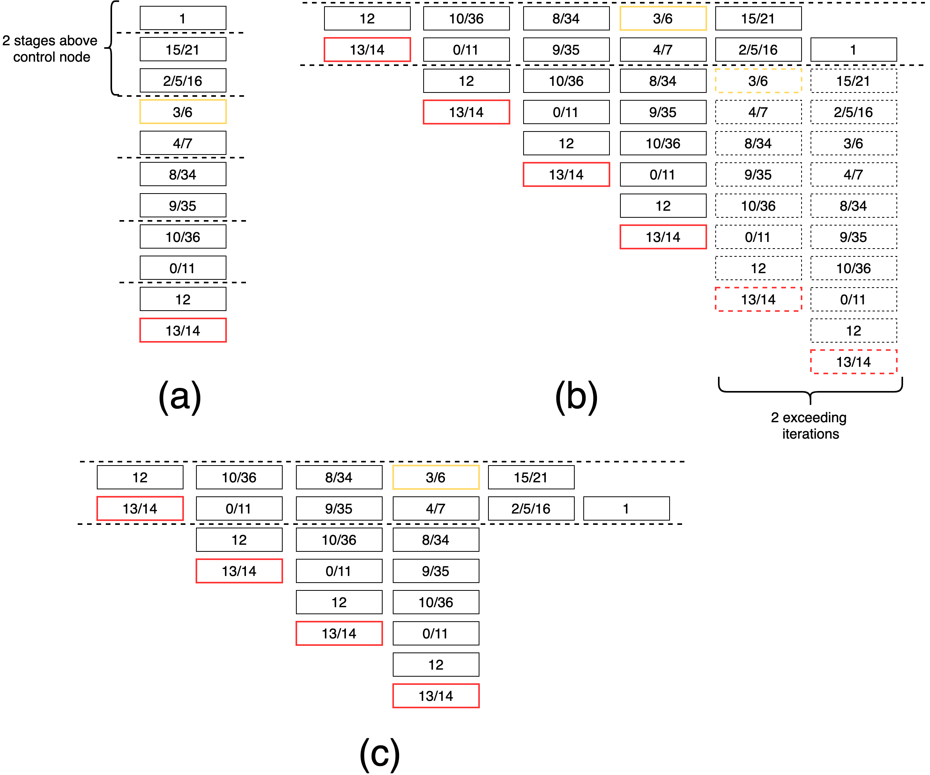
COMSAT – Epilog Adjustment
The number of stages scheduled before control node equals the number of exceeded iterations as CGRA exits loop
The exceeded iteration can be partially removed in epilog stage
Under an assumption: control node scheduled before liveout nodes in an iteration’s schedule
Control node
Liveout node

Slide 14
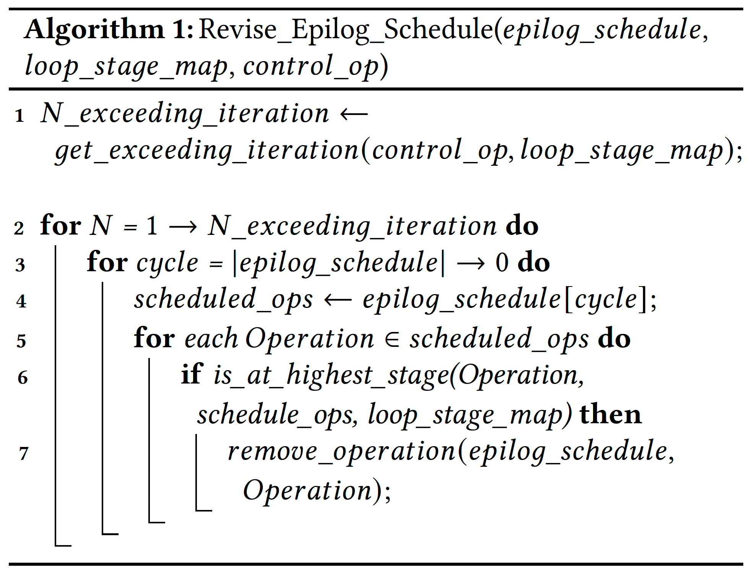
Algorithm for Epilog Adjustment
1
15/21
2/5/16
1
3/6
15/21
4/7
2/5/16
1
8/34
3/6
15/21
9/35
4/7
2/5/16
1
10/36
8/34
3/6
15/21
0/11
9/35
4/7
2/5/16
1
12
10/36
8/34
3/6
15/21
13/14
0/11
9/35
4/7
2/5/16
1
12
10/36
8/34
3/6
15/21
13/14
0/11
9/35
4/7
2/5/16
1
12
10/36
8/34
3/6
15/21
13/14
0/11
9/35
4/7
2/5/16
12
10/36
8/34
3/6
13/14
0/11
9/35
4/7
12
10/36
8/34
13/14
0/11
9/35
12
10/36
13/14
0/11
12
13/14

Slide 15
1
1st iteration condition
15/21
2/5/16
1
2nd iteration condition
Running GEMM for 3 iterations
3/6
15/21
3rd iteration condition
4/7
2/5/16
1
Cannot exit in Prolog
8/34
3/6
15/21
9/35
4/7
2/5/16
1
10/36
8/34
3/6
15/21
0/11
9/35
4/7
2/5/16
1
12
10/36
8/34
3/6
15/21
Loop Exit
Kernel Start
13/14
0/11
9/35
4/7
2/5/16
1
12
10/36
8/34
3/6
15/21
Kernel End
13/14
0/11
9/35
4/7
2/5/16
1
12
10/36
8/34
3/6
15/21
13/14
0/11
9/35
4/7
2/5/16
12
10/36
8/34
3/6
3rd iteration liveOut
13/14
0/11
9/35
4/7
12
10/36
8/34
13/14
0/11
9/35
Exceeded liveOuts
12
10/36
13/14
0/11
12
13/14

Slide 16
COMSAT – Prolog Schedule Generation
1
2/5/16
4/7
2/5/16
There can be duplicates of control node from multiple iteration scheduled in prolog stage
For every control node in prolog, a version of prolog schedule is generated
As a control node signals to terminate loop in prolog stage, CGRA jumps to the according schedule
15/21
5 prolog versions
3/6
8/34
3/6
2/5/16
1
4/7
9/35
4/7
3/6
15/21
8/34
10/36
8/34
4/7
2/5/16
1
9/35
0/11
9/35
8/34
3/6
15/21
10/36
12
10/36
9/35
4/7
2/5/16
1
0/11
13/14
0/11
10/36
8/34
3/6
15/21
12
12
0/11
9/35
4/7
2/5/16
1
13/14
13/14
12
10/36
8/34
3/6
15/21
Version 0
Version 1
13/14
0/11
9/35
4/7
2/5/16
1
9/35
4/7
2/5/16
0/11
9/35
4/7
2/5/16
13/14
0/11
9/35
4/7
2/5/16
10/36
8/34
3/6
12
10/36
8/34
3/6
12
10/36
8/34
3/6
0/11
9/35
4/7
13/14
0/11
9/35
4/7
13/14
0/11
9/35
4/7
12
10/36
8/34
12
10/36
8/34
12
10/36
8/34
13/14
0/11
9/35
13/14
0/11
9/35
13/14
0/11
9/35
12
10/36
12
10/36
12
10/36
13/14
0/11
13/14
0/11
13/14
0/11
12
12
12
13/14
13/14
13/14
Version 2
Version 3
Version 4

Slide 17
Schedule Branching Support
Executed Schedule
4/7
2/5/16
Since generated schedules are appended to the original prolog schedule, branch targets are calculated by relative offsets and CGRA skips said offsets when terminate signal asserts
Branching required for exits in prolog stage
Instruction format changed
1
0/11
4/7
2/5/16
0/11
9/35
2/5/16
2/5/16
13/14
4/7
9/35
9/35
4/7
2/5/16
8/34
10/36
8/34
3/6
12
10/36
3/6
15/21
12
3/6
8/34
3/6
10/36
8/34
3/6
9/35
2/5/16
0/11
9/35
4/7
2/5/16
1
9/35
0/11
4/7
9/35
13/14
4/7
13/14
4/7
0/11
4/7
10/36
10/36
12
10/36
8/34
3/6
15/21
12
8/34
10/36
8/34
8/34
12
8/34
0/11
0/11
9/35
2/5/16
0/11
13/14
9/35
0/11
2/5/16
1
9/35
4/7
9/35
13/14
13/14
9/35
12
12
10/36
8/34
3/6
15/21
10/36
12
10/36
10/36
12
10/36
0/11
13/14
0/11
9/35
2/5/16
1
0/11
13/14
0/11
13/14
13/14
0/11
4/7
2/5/16
10/36
12
12
8/34
3/6
15/21
12
12
12
0/11
9/35
2/5/16
2/5/16
1
13/14
13/14
4/7
13/14
13/14
13/14
12
10/36
8/34
3/6
15/21
Version 0
Version 4
Version 1
Version 3
Version 2
13/14
0/11
9/35
2/5/16
1
4/7
2/5/16
Notes:
Each exit evaluated by a control node jumps to the corresponding prolog schedule version
Each generated schedule version completes previous and current iterations and excludes succeeding ones
To facilitate branches, instructions for control nodes are modified by instruction generator to include branch targets

Slide 18
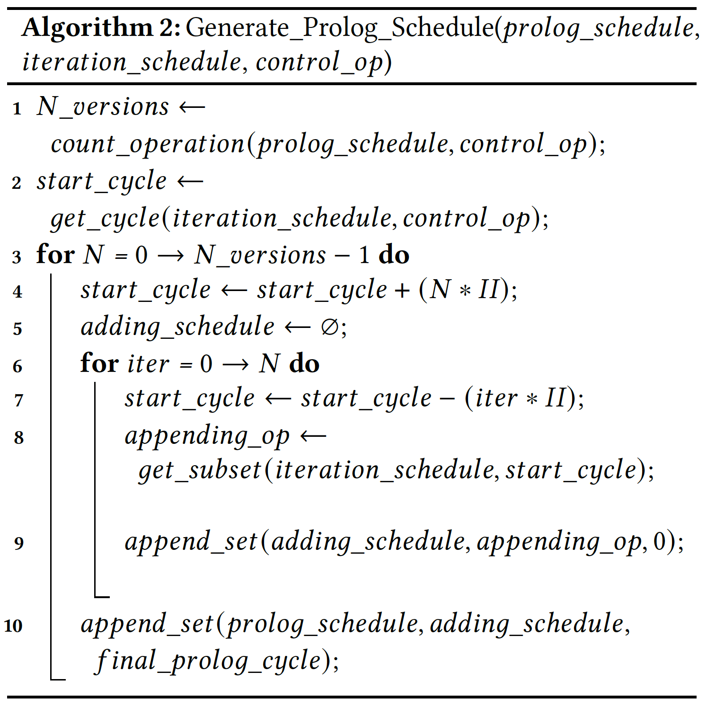
Algorithm for Prolog Schedule Generation
1
1
2/5/16
15/21
5 prolog versions
Start
Cycle
15/21
3/6
2/5/16
1
2/5/16
4/7
3/6
15/21
Start
Cycle
3/6
8/34
4/7
2/5/16
1
4/7
9/35
8/34
3/6
15/21
Start
Cycle
8/34
10/36
9/35
4/7
2/5/16
1
9/35
0/11
10/36
8/34
3/6
15/21
Start
Cycle
10/36
12
0/11
9/35
4/7
2/5/16
1
0/11
13/14
12
10/36
8/34
3/6
15/21
Start
Cycle
12
Version 0
13/14
0/11
9/35
4/7
2/5/16
1
13/14
Prolog Schedule
Iteration Schedule
4/7
2/5/16
9/35
4/7
2/5/16
0/11
9/35
4/7
2/5/16
13/14
0/11
9/35
4/7
2/5/16
8/34
3/6
10/36
8/34
3/6
12
10/36
8/34
3/6
12
10/36
8/34
3/6
9/35
4/7
0/11
9/35
4/7
13/14
0/11
9/35
4/7
13/14
0/11
9/35
4/7
10/36
8/34
12
10/36
8/34
12
10/36
8/34
12
10/36
8/34
0/11
9/35
13/14
0/11
9/35
13/14
0/11
9/35
13/14
0/11
9/35
12
10/36
12
10/36
12
10/36
12
10/36
13/14
0/11
13/14
0/11
13/14
0/11
13/14
0/11
12
12
12
12
13/14
13/14
13/14
13/14
Version 1
Version 2
Version 3
Version 4

Slide 19
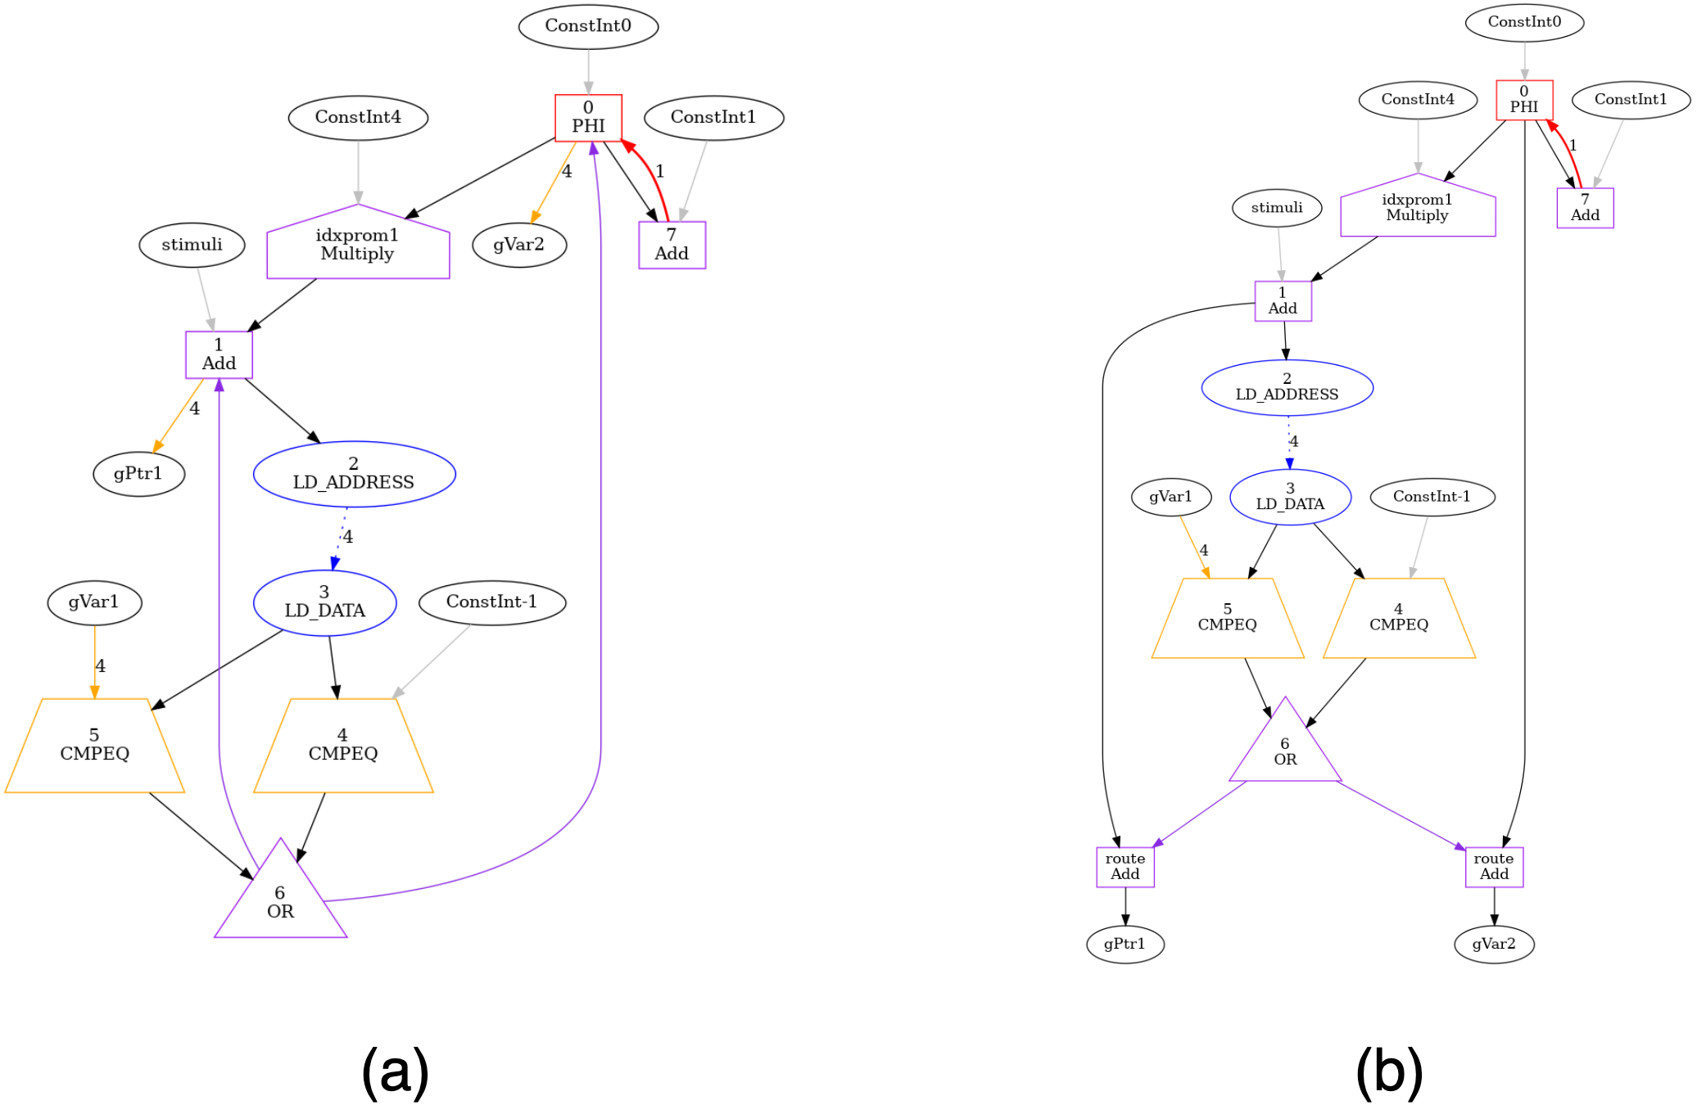
COMSAT – Circular Dependency
Liveout nodes
When apply the assumption to scheduling techniques, circular dependency may be found
Happens when a data path is found from liveout to control node
Circular graphs are broken by adding a route node from the liveouts
Control nodes
Routed liveouts

Slide 20
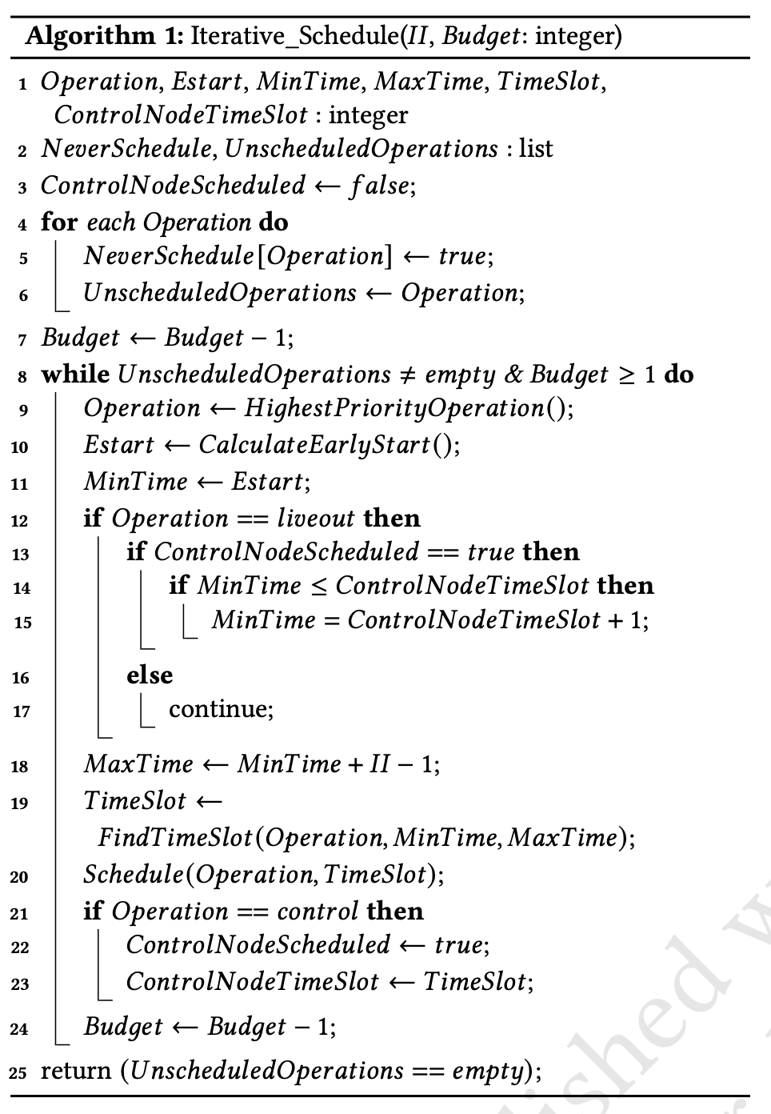
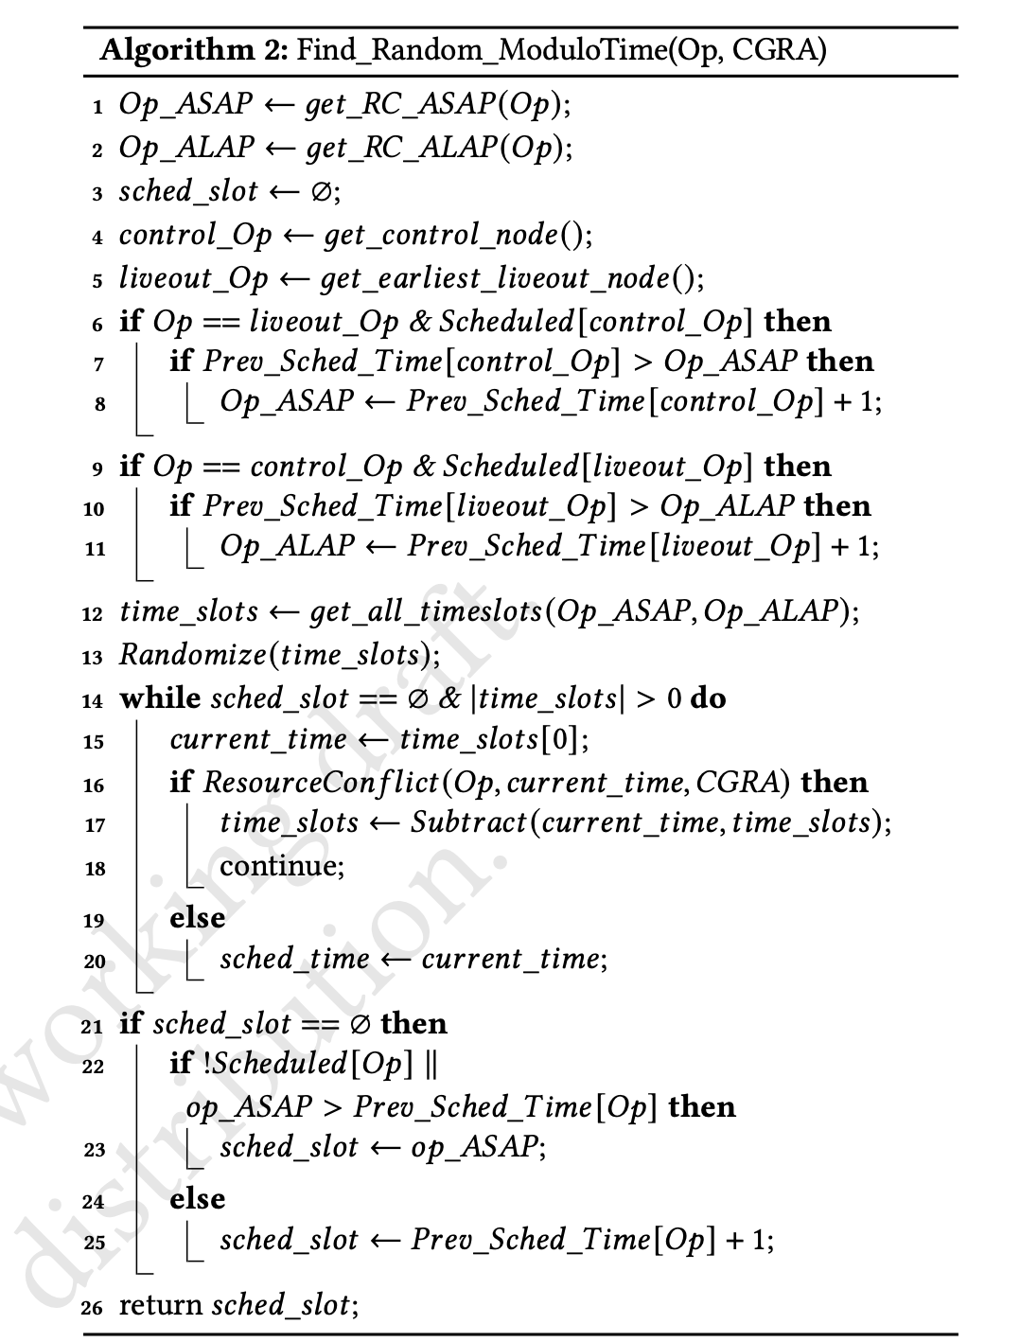
Constraint Implementation
Modified IMS scheduling algorithm
Modified CRIMSON scheduling algorithm

Slide 21
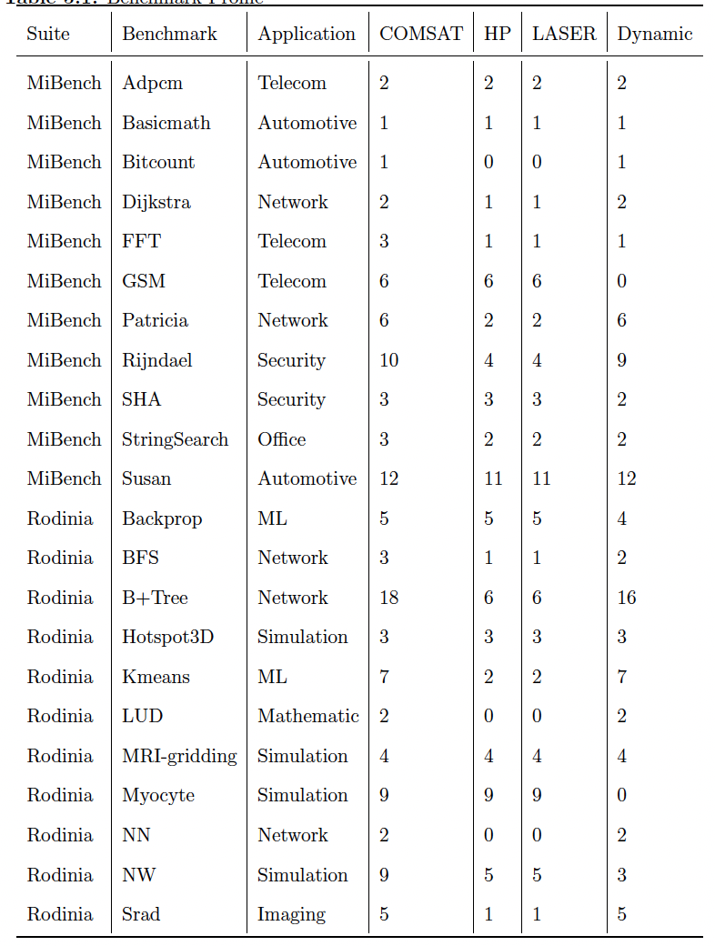
COMSAT Applicability
Benchmark profile:
75% of all loops are dynamic
HP and LASER enabled only 67% of COMSAT loop accelerations
Notes:
Dynamic loops rely on COMSAT for accurate execution since they have unknown trip counts, fewer trip count or exit statements
These loops account for 75% of all loops found in MiBench and Rodinia suites
Without COMSAT, execution on dynamic loops require manual adjustment to accommodate for trip count
The rest 25% of loops found in GSM, Myocyte and Needleman-Wunsch have predetermined amount of computations and may be better accelerated using other techniques, such as vectorization, loop unrolling

Slide 22
COMSAT Applicability
GSM, Myocyte and NW are compute-intensive applications
Not written to run on loops
Better accelerations through multi-threading techniques
Notes:
Dynamic loops rely on COMSAT for accurate execution since they have unknown trip counts, fewer trip count or exit statements
These loops account for 75% of all loops found in MiBench and Rodinia suites
Without COMSAT, execution on dynamic loops require manual adjustment to accommodate for trip count
The rest 25% of loops found in GSM, Myocyte and Needleman-Wunsch have predetermined amount of computations and may be better accelerated using other techniques, such as vectorization, loop unrolling

Slide 23
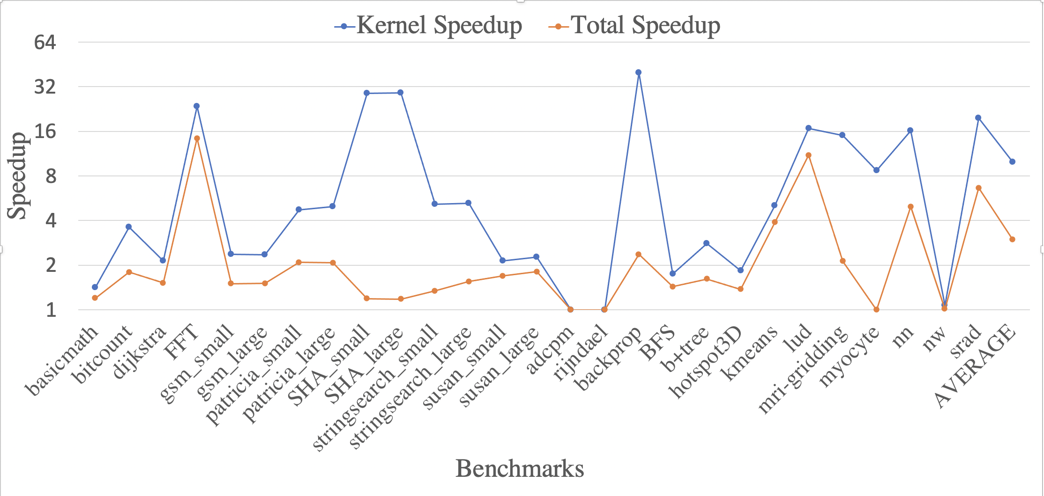
COMSAT-Enabled Speedups
Experiments run on ARMv7a single-core, single-threaded processor, coupled with CGRA
Total speedups trend with kernel speedups, showing the dominance of accelerating these loops w.r.t entire programs
COMSAT enabled average speedups of 3x and 10x for total and kernel cycles
Notes:
With exceptions of SHA and myocyte, kernel speedup trends with total speedup

Slide 24
COMSAT-Enabled Speedups
Good kernel speedups but low total speedup
Because kernel loop size is relatively small

Slide 25
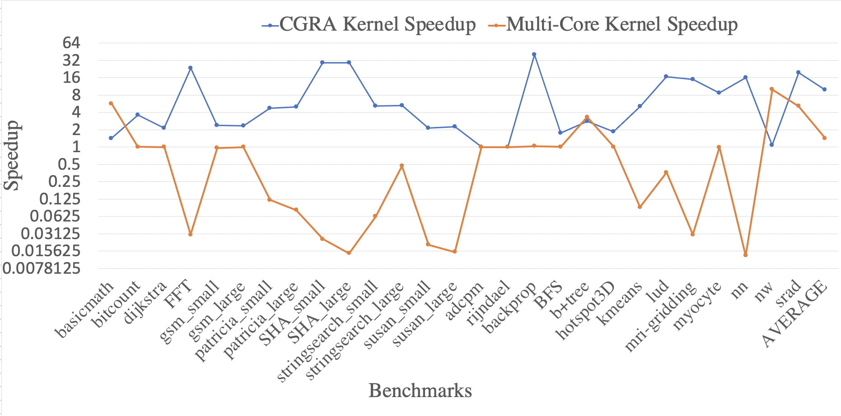
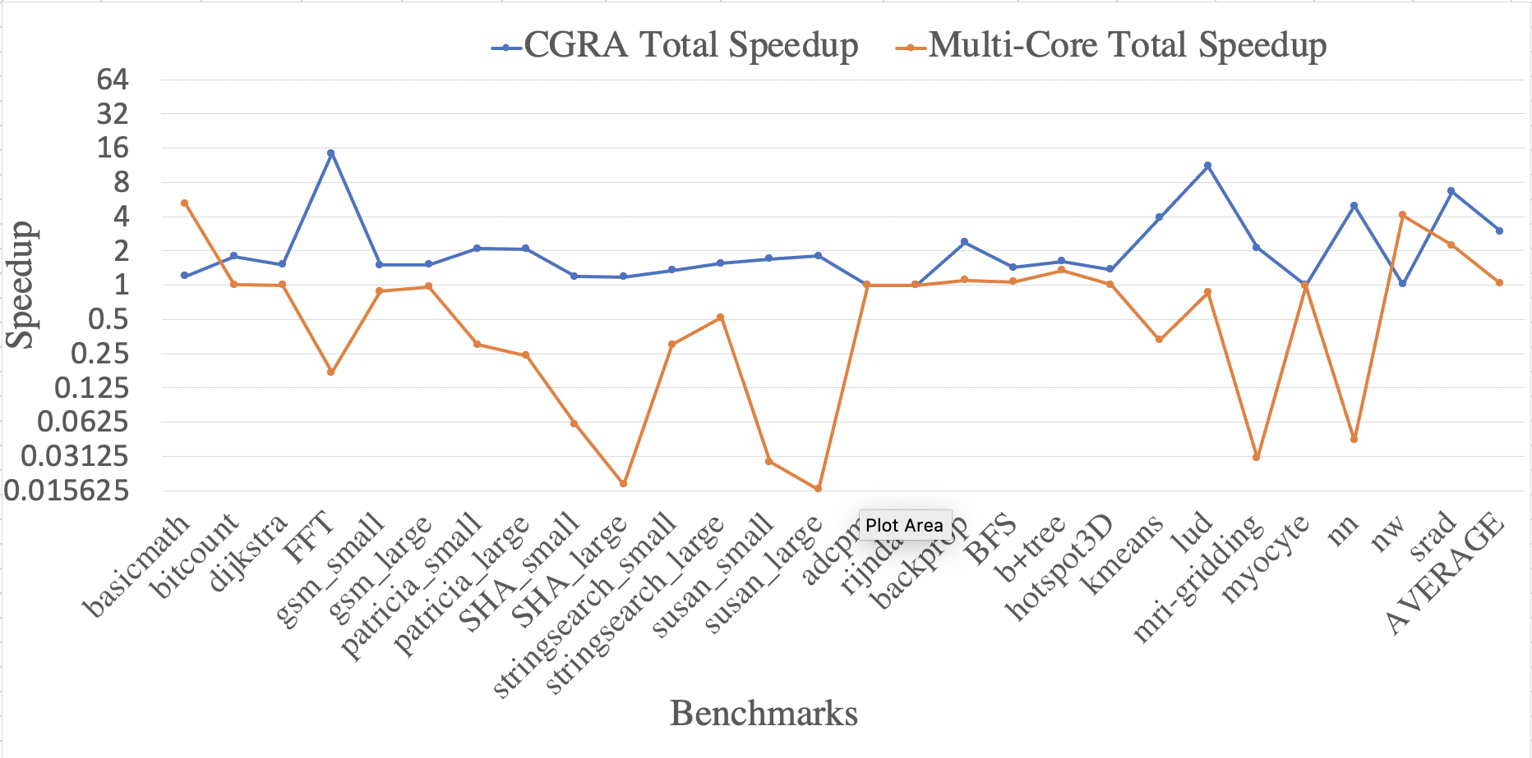
CGRA vs Multi-Core CPU Speedups
Kernel Speedups
Total Speedups
Multi-Core CPU Setup:
16 threads/cores
Supported by OpenMP
Why multi-threaded slows down execution?
Thread creation/switching overhead
OpenMP works best on parallel loops
Only found in Basicmath, B+Tree, NW

Slide 26
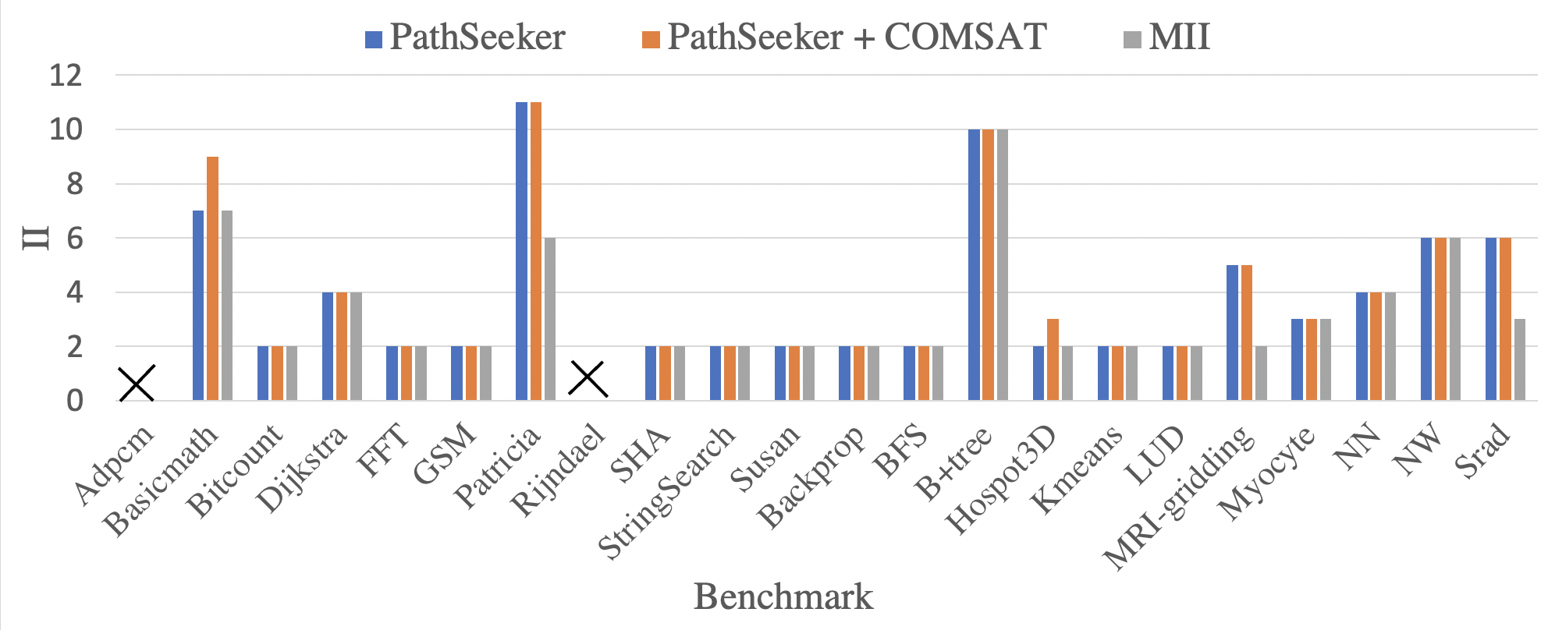
COMSAT Effects on Mapping Quality
COMSAT scheduling constraint lowers scheduling performance
LiveOuts have to be routed down the iteration, increasing loop size
Only happen in small loops where computation branch is shorter than control branch
Notes:
- COMSAT mapping constraint has effects on mapping quality because it requires live out nodes to be scheduled after control nodes
- When the constraint is not met, liveOuts have to be routed down the iteration, adding routing nodes and mapping complexity
COMSAT’s constraint is implemented into CRIMSON and mappings generated by PathSeeker
Constraints only happen in small loops when control branch is shorter than computation branch

Slide 27
COMSAT Effects on Mapping Quality
COMSAT only shows effects in Basicmath and Hotspot3D benchmarks
Adpcm and Rijndael failed to find mappings even without COMSAT because of their loop sizes and constrained mapping time
Notes:
- COMSAT mapping constraint has effects on mapping quality because it requires live out nodes to be scheduled after control nodes
- When the constraint is not met, liveOuts have to be routed down the iteration, adding routing nodes and mapping complexity
COMSAT’s constraint is implemented into CRIMSON and mappings generated by PathSeeker
Constraints only happen in small loops when control branch is shorter than computation branch

Slide 28
Questions

